Slide 1





Data Science and Business
Predicting & Understanding Customer Churn
SyriaTelecommunications

Slide 2

TITLE: SYRIATEL CUSTOMER CHURN ANALYSIS

Slide 3

The SyriaTel Customer Churn project aims to predict customer churn for the telecommunications company, SyriaTel, by analyzing a dataset containing information on customer behavior, plan details, and churn status.
obectives

Slide 4
Based on the provided dataset of 3333 customers who have held accounts with SyriaTel for less than 243 days,The project aims to provide SyriaTel with data-driven insights to reduce customer churn rates, enhance customer satisfaction, and optimize retention strategies in the competitive telecom industry landscape.

Slide 5
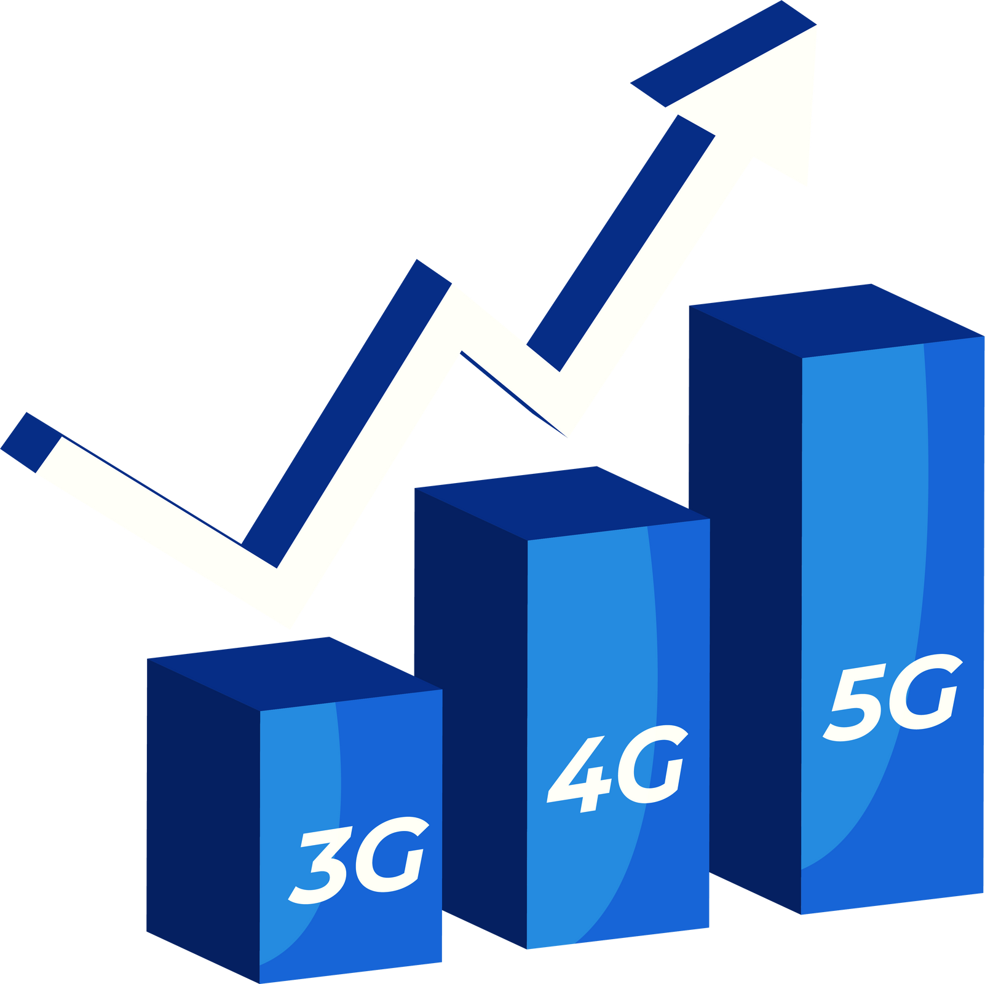
Data overview
Inferential Statistics
Predictive Modeling
Model Evaluation
Insights & Recommendations
Best Model & Results
Future Investigations & Recommendations
Go Back to Agenda Page

Slide 6









Methodology
Classification Models Used:
Decision Tree
Logistic Regression
KNN (K-Nearest Neighbors)
Random Forest
Gradient Boost
Evaluation Metrics:
Recall Score: Used as a key metric to evaluate model performance.
Model Performance Assessment:
Models were evaluated based on the recall score metric and confusion matrices to assess their effectiveness in predicting customer churn.
This methodology involved testing various classification models and assessing their performance using the recall score metric, providing valuable insights into the predictive capabilities of each model in forecasting customer churn for SyriaTel.

Slide 7

Results
The best performing model in the SyriaTel Customer Churn analysis was the Gradient Boost model, achieving a recall score of 0.81 on the test data. This model outperformed previous models, showcasing a significant improvement in performance. The comparison with other models highlighted the effectiveness of Gradient Boost in accurately predicting customer churn, providing valuable insights for SyriaTel to enhance their customer retention strategies.

Slide 8
Findings
Customer Segmentation: The majority of churning customers (84%) had less than 100 international plan minutes.
Call Usage: Customers with higher call charges were more likely to churn.
Customer Service Interaction: Customers with higher customer service call durations were more likely to churn.
International Plan Usage: Customers with active international plans were less likely to churn.

Slide 9
Recommendations
Based on the predictive modeling results, SyriaTel should focus on improving customer service offerings, implementing tiered pricing structures, and retaining customers with active international plans.

Slide 10
Conclusion
Improve Customer Service Offerings: Enhance customer service offerings by improving response times, addressing customer concerns more effectively, and providing better support for international plan usage.
Implement Tiered Pricing Structures: based on call usage, international plan minutes, and other relevant factors to cater to different customer segments.
Retain Customers with Active International Plans: Focus on retaining customers with active international plans by offering attractive benefits and promotions.
Continuous Learning and Improvement: improve customer service offerings, pricing structures, and retention strategies.

Slide 11

Thank you!

